Slide 1
Magnus Effect on a Cylindrical Airfoils
Zhangxi ‘Jesse’ Feng, Simon Popecki, James Skinner
Advisor - Samuel Cole
May 5th, 2017

Slide 2
Statement of purpose
Experimentally observe the effect of a cylinder’s radius on the lift force
Evaluate how wind speed will affect the resulting lift force at various rpms

Slide 3
Background
The Magnus effect is a commonly observed effect in which a spinning ball or cylinder curves away from its given path
The

Slide 4
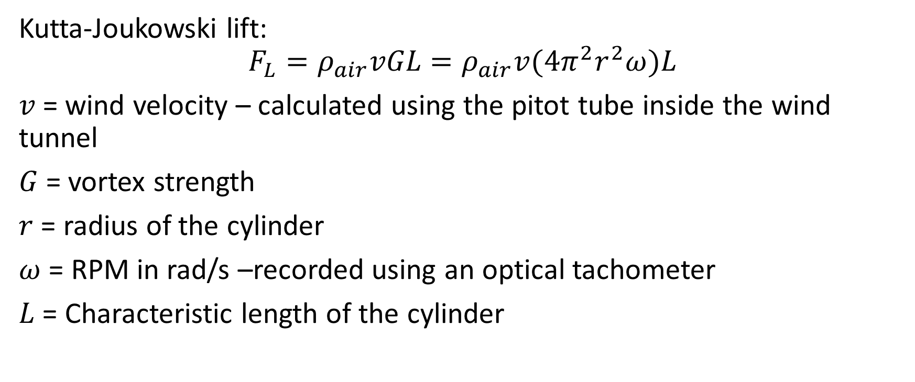
Governing Equation
Kutta-Joukowski lift:
$$F_{L}=ρ_{air}vGL=ρ_{air}v(4π^{2}r^{2}ω)L$$
$v$= wind velocity – calculated using the pitot tube inside the wind tunnel
$G$= vortex strength
$r$ = radius of the cylinder
$ω$ = RPM in rad/s –recorded using an optical tachometer
$L$ = Characteristic length of the cylinder

Slide 5
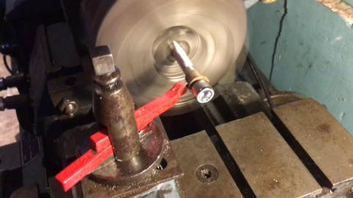


Preparation

Slide 6
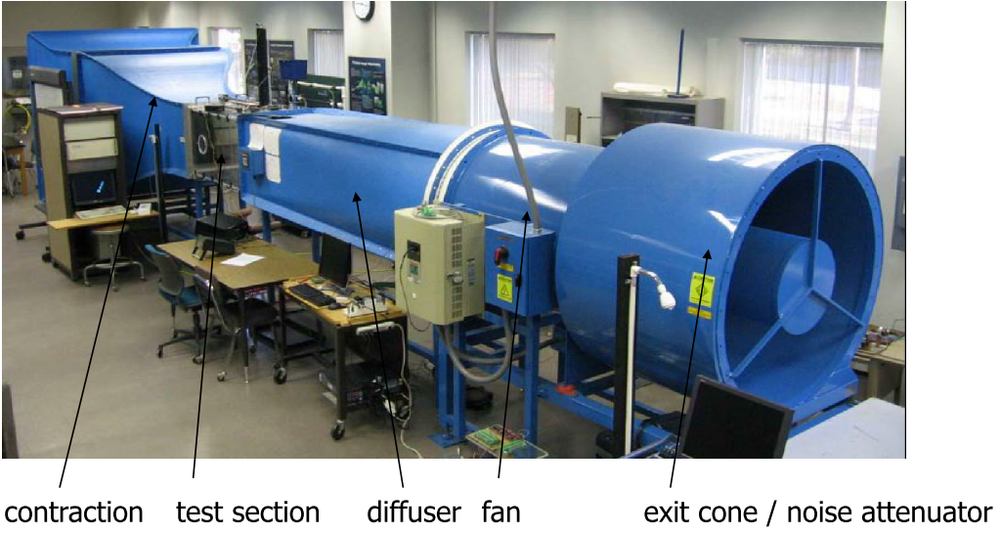
Experimental Method

Slide 7

Equipment Used
Motor - Mega Motor ACn 16/15/8
Electronic Speed Controller (ESC) – Thunderbird 18
Transmitter – Spektrum dx6i
Receiver – Spektrum Bot BR6000
Optical tachometer
(Insert picture of all materials here)

Slide 8
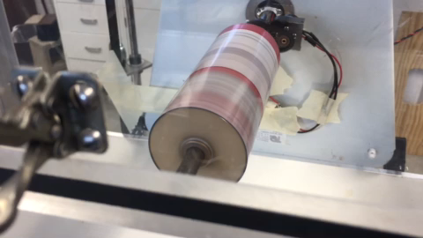
Budweiser Experimental Setup

Slide 9
Results and Discussion

Slide 10
Results and Discussion
The Budweiser Airfoil was

Slide 11
Results and Discussion
The Quaker Oat Airfoil was

Slide 12
Summary of observations

Slide 13
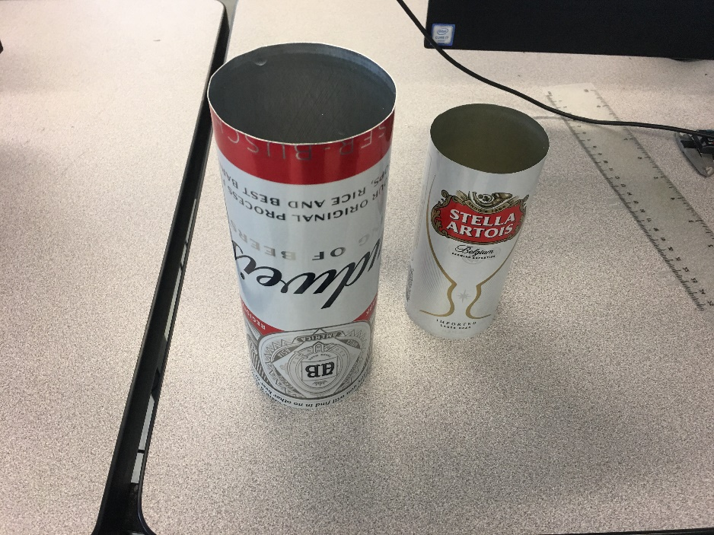
Acknowledgements
Professor Todd Gross, Ivaylo Nedyalkov, and Samuel Cole for their assistance with our experiment
No thanks to the difficulty delivered to us by the force balance
Additionally, Evan Grissino for helping to make it possible to create our airfoils

